Slide 1

Data Governance in Energy Sector Critical Infrastructure Environment
Security Incidents in Mind
Szabolcs Hallai – CISA,CISM, CITRM, C|CISO
Chief information Security OFFicer and Data Protection Officer
Hungarian ENeRGY AGENCY

Slide 2

AGENDA
Data governance in general
Data governance framework and how to reach it
Data governance in energy sector critical infrastructure
Incident handling with data governance
Possible solutions
Wider perspective
Q&A

Slide 3
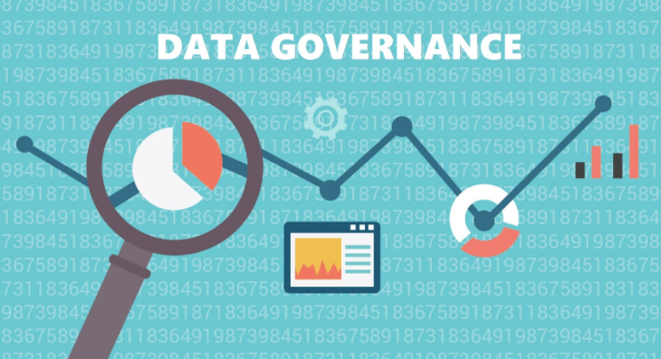
Data governance in general*
Data governance is a data management concept concerning the capability that enables an organization to ensure that high data quality exists throughout the complete lifecycle of the data.
According to one vendor, data governance is a quality control discipline for assessing, managing, using, improving, monitoring, maintaining, and protecting organizational information.
It is a system of decision rights and accountabilities for information-related processes, executed according to agreed-upon models which describe who can take what actions with what information, and when, under what circumstances, using what methods.
*source Wikipedia - https://en.wikipedia.org/wiki/Data_governance

Slide 4

Data governance framework and how to reach it
CobIT (2019) - Control Objectives for Information and Related Technologies
  The framework defines a set of generic processes for the management of IT, with each process defined together with process inputs and outputs, key process-activities, process objectives, performance measures and an elementary maturity model
Five processes are identified: Evaluate, Direct and Monitor (EDM); Align, Plan and Organize (APO); Build, Acquire and Implement (BAI); Deliver, Service and Support (DSS); and Monitor, Evaluate and Assess (MEA)
If you use ITIL and/or ISO 27k you can map your processes into COBIT

Slide 5
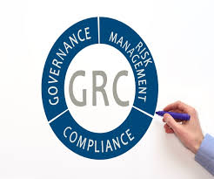
Data governance framework and how to reach it
GRC Tools available in large number – you will need it
  RSA Archer, SAP GRC, ACL GRC, Avedos Risk2Value
Establishing the position of RMO (risk management officer)
List of Data Assets (map of corporate data)
Compliance concerns addressed (GDPR, NIS directive, CIP legal framework, local cybersecurity and information security legislation)

Slide 6
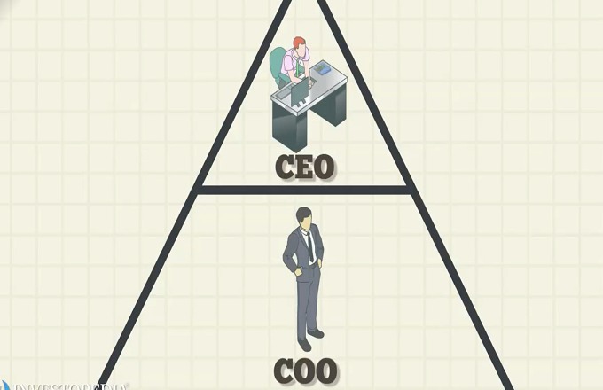
Data governance in energy sector critical infrastructure
Map of data (SCADA data, PLC, OPDM/ATOM, balancing systems, smart grid components, logs, update data, change, smart metering and interface to billing system etc.)
Classification of data / data responsible
GDPR related issues – DPO (own map)
Data/systems table (for CIO, CISO)
RMO role to process and prepare reports to C-exec
Operational risk status/dashboard or pdf on COO/CEO desk in the morning (CIO, CISO)

Slide 7

Incident handling with data governance
SIEM process intregration (CISO)
Standard IT log integration (CIO) – NAGIOS etc.
SOC analysis integration (analyzis dashboard summary)
Incident handling process (27k) integrated to COBIT processes

Slide 8

Possible solutionS – A PROJECT
CIO/CISO initiative
RMO (risk based) initiative
COO based initiative
CEO/board based initiative
2-4 years to implement, PDCA, QA

Slide 9
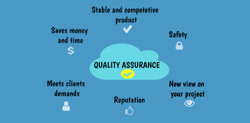
Wider perspective
IT/ITSEC operational awareness of C-level
Easy integration to PPP (cyber range exercises, e-ISAC, country CSIRT)
Proper incident handling for the company
QA Branding as strong data protector company – GDPR, NIS

Slide 10

Questions?

Slide 11
Thank you!
Szabolcs Hallai – CISA, CISM, CITRM, C|CISO
You can reach me at:
hallai.szabolcs@itbc.hu
https://hu.linkedin.com/in/hallaiszabolcs
@SzabolcsHallai - twitter

